Slide 1
DSC 640 – Week 5 & 6 Michael Ersevim

Slide 2
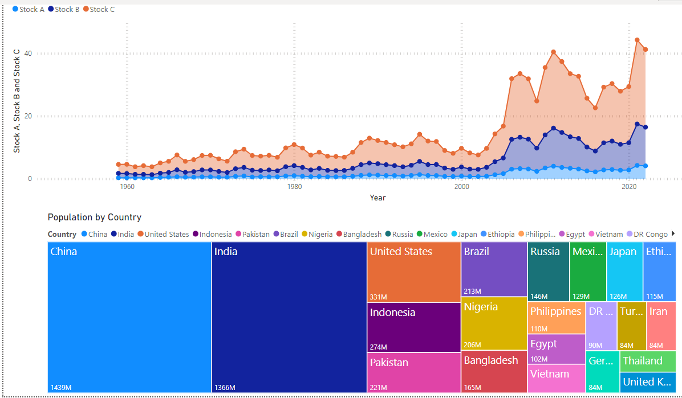
Power BI: Stacked Area graph of 3 stocks and Treemap of largest countries

Slide 3
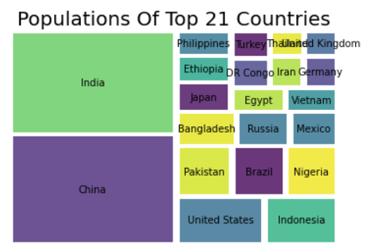
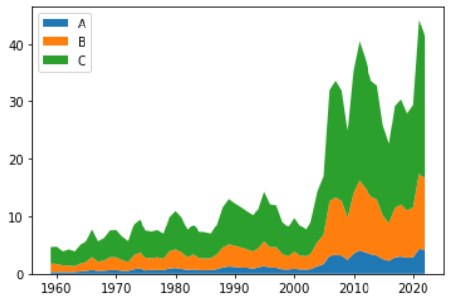
Python: Treemap of world population
Python: Stacked Area graph of stock prices

Slide 4
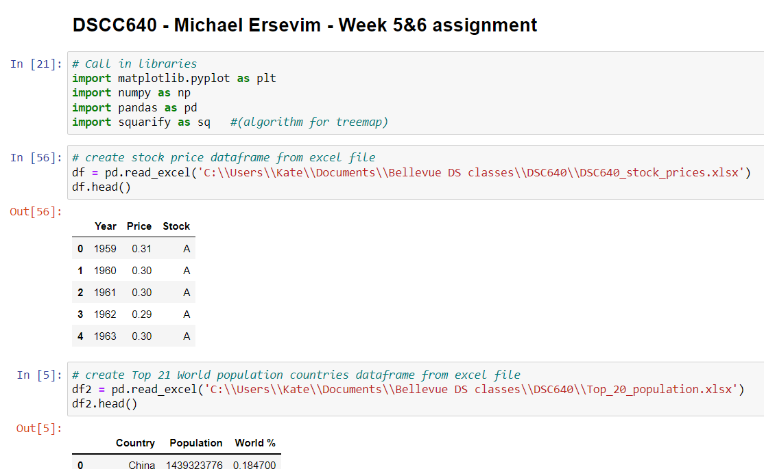
Python: CODE for generating prior graphs

Slide 5
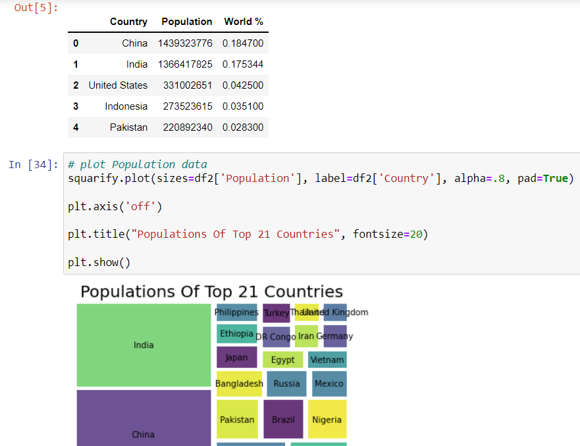
Python: CODE for generating prior graphs

Slide 6
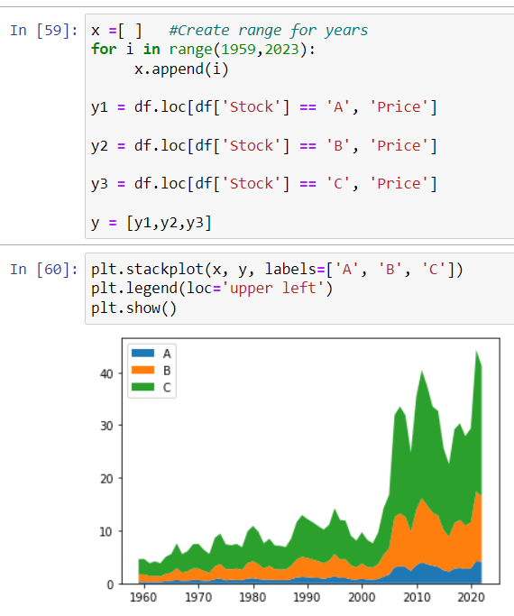
Python: CODE for generating prior graphs

Slide 7
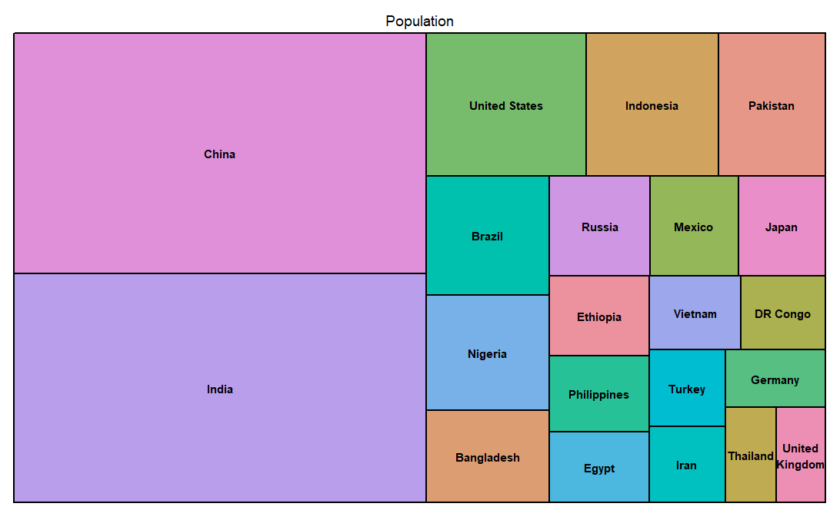
R: Treemap of world population

Slide 8
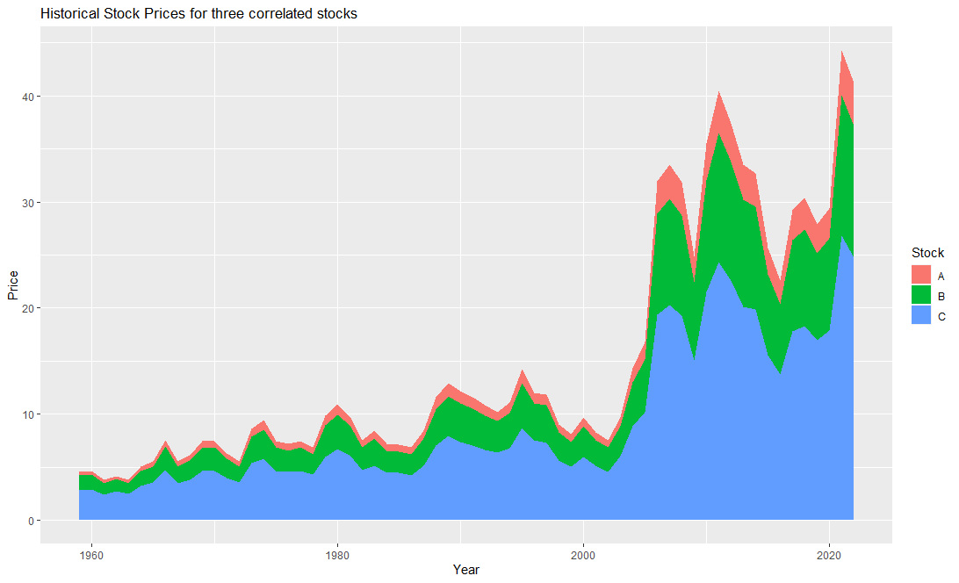
R: Stacked Area graph of 3 stocks

Slide 9
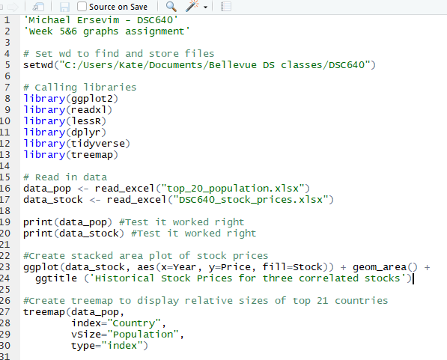
R: Code for Stacked Area Graph and Treemap of world population

